Slide 1
From Microsoft to Mobile Learning Xamarin.Forms through UWP
Andy Lech
XamarinFiles.com
github.com/xamarinfiles
@XamarinFiles

Slide 2
Meet Xamarin.Forms
Build native UIs for iOS, Android, and Windows
from a single, shared C# codebase.

Slide 3
Xamarin.Forms - 3 Native UIs, Same Code Base
iOS C# UI
Android C# UI
Windows C# UI
Shared C# User Interface
Shared C# App Logic

Slide 4
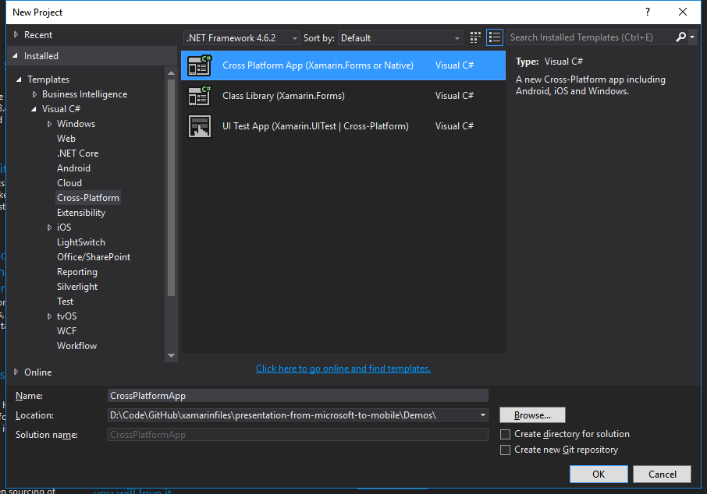
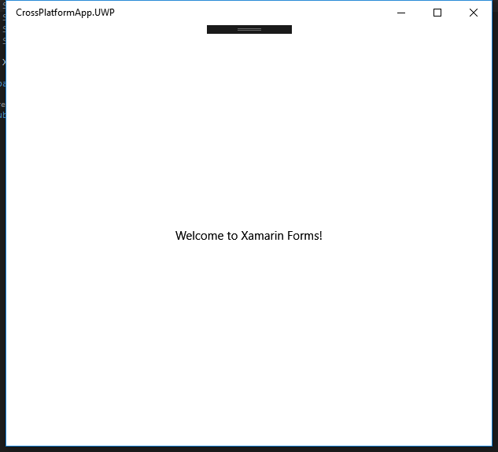
Demo – Blank Cross Platform App
Shared C# User Interface

Slide 5
Why Mobile Development?

Slide 6
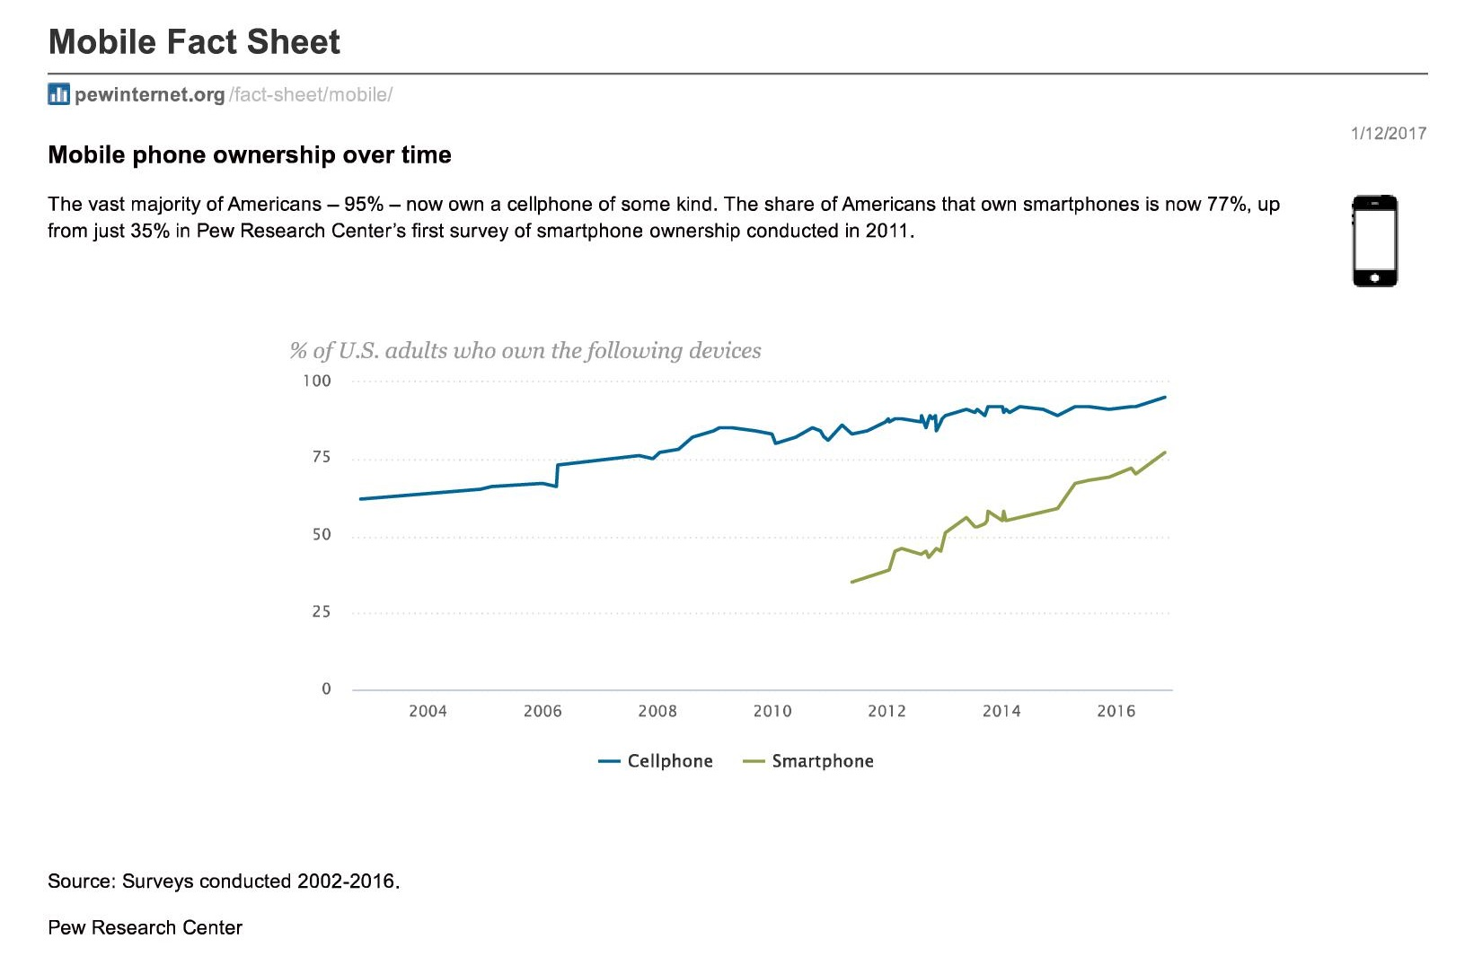
www.pewinternet.org/fact-sheet/mobile/
Notes:
As of 2016, 77% of Americans own a smartphone

Slide 7
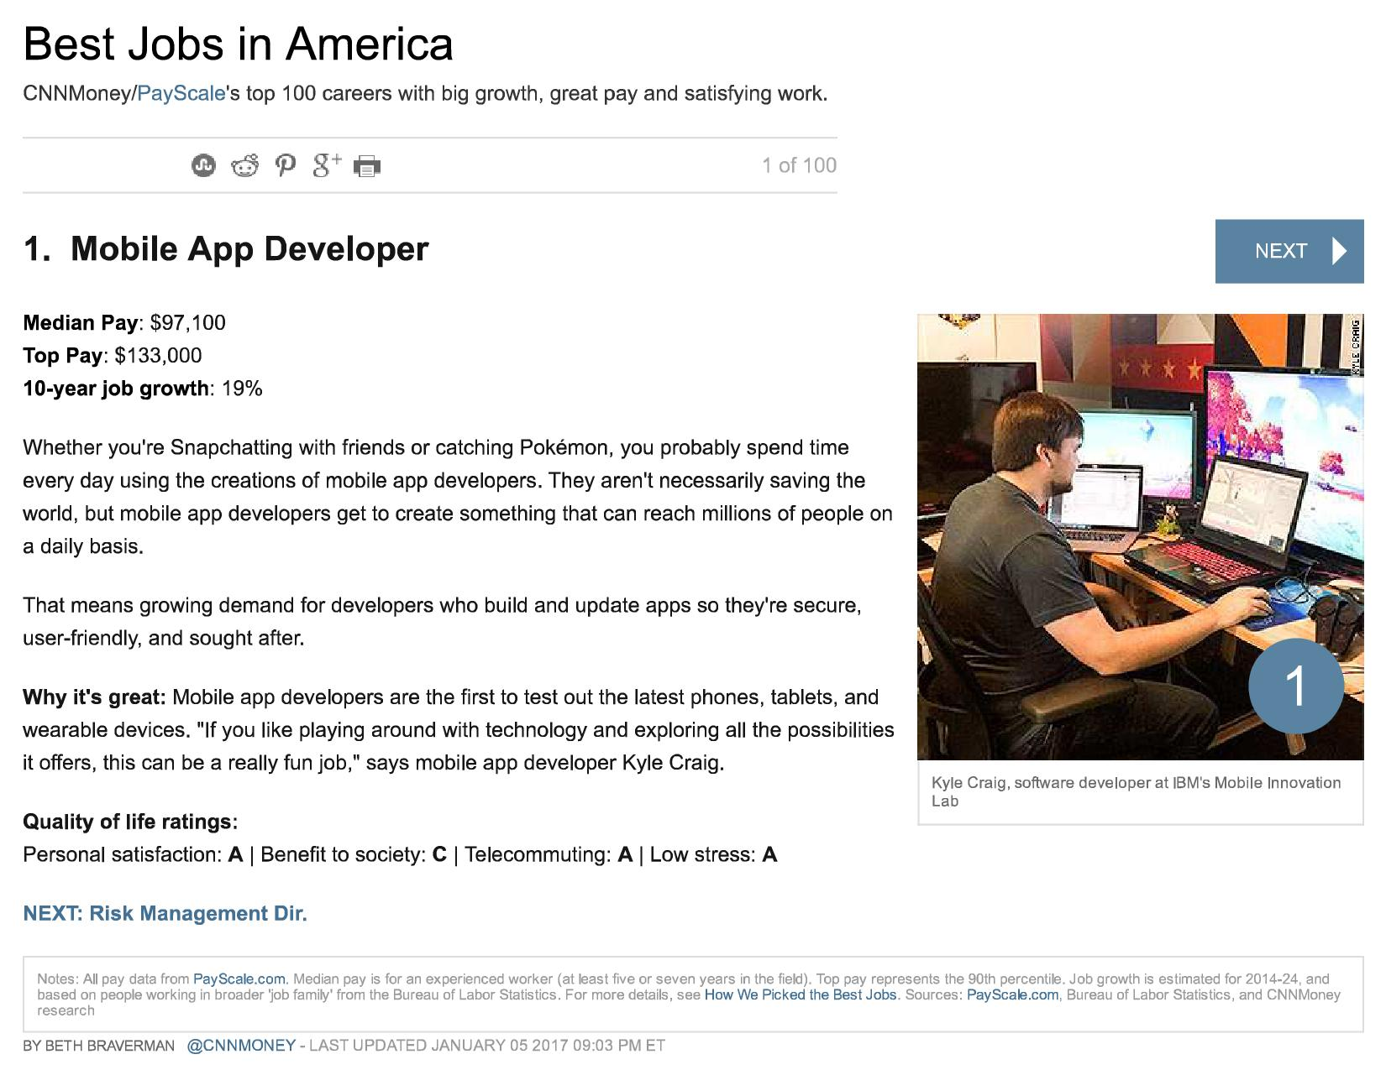
money.cnn.com/gallery/pf/2017/01/05/best-jobs-2017/index.html

Slide 8
Challenges of Mobile Development

Slide 9
On Mobile, Quality is Hard
7
20
20
35
6
OS versions
Devices
Languages
Locales
Screen sizes
10
24K+
39
57
27
15
6
OS versions
Distinct devices
Languages
Locales
Screen sizes
Manufacturers
Screen configurations
Notes:
First let’s take a look at the shear number of configurations there are between iOS and Android. As iOS progresses this number is only set to increase, and on Android it is already a HUGE number of configurations to even think about testing.
iOS: 7, 7.1, 8, 8.1, 8.2, and iOS 9, iOS 9.1

Slide 10








App Complexity
Thousands of iOS and Android APIs
Public web APIs
Backend integrations
Third party libraries
Memory, CPU and network constraints
Notes:
The fragmentation isn’t just in the devices, but as we start to build on our applications you soon found out they are ever increasingly complex.

Slide 11
How Xamarin Helps

Slide 12
Silo Approach
iOS
Android
Windows
Objective-C
Xcode
Java
Android Studio
C#
Visual Studio
No shared code • Many languages & development environments • Multiple teams
Notes:
Multiple Teams
Multiple Code Bases
Expensive & Slow
Positive = Great apps delivered to user’s platform
Negative = Development hampered by multiple code bases & fragmentation

Slide 13
Xamarin’s Unique Approach
iOS C# UI
Android C# UI
Windows C# UI
Shared C# Mobile
Shared C# codebase • 100% native API access • High performance

Slide 14
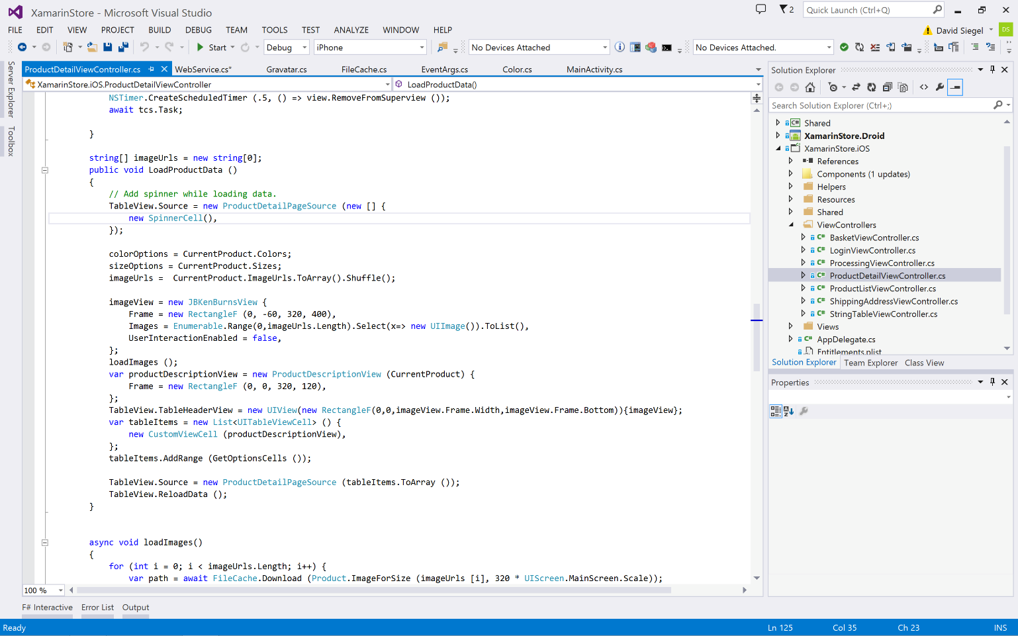
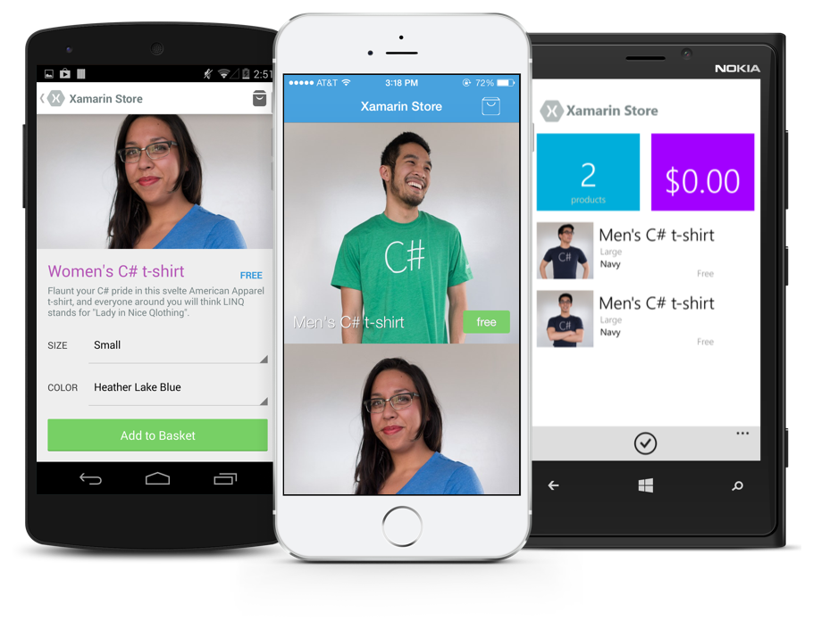
Anything you can do in Objective-C, Swift, or Java can be done in C# and Visual Studio with Xamarin.
Notes:
Coming up next is bubbles

Slide 15
How Xamarin.Forms Helps

Slide 16
Xamarin + Xamarin.Forms
iOS C# UI
Android C# UI
Windows C# UI
Shared UI Code
Shared C# Backend
Shared C# Backend
Traditional Xamarin Approach
With Xamarin.Forms: More code-sharing, all native

Slide 17
What’s included
✓ 40+ Pages, layouts, and controls
(Build from code behind or XAML)
✓ Two-way data binding
✓ Navigation
✓ Animation API
✓ Dependency Service
✓ Messaging Center
Shared UI Code
Shared C# Backend

Slide 18
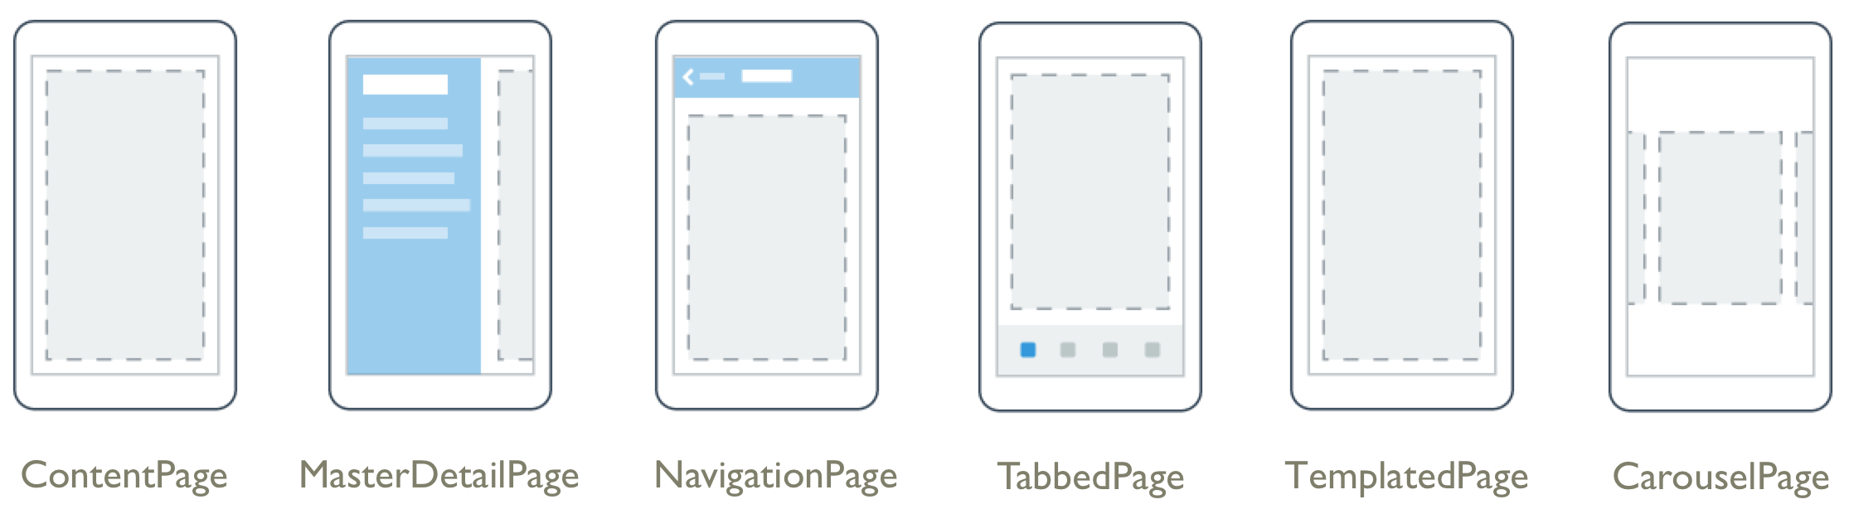
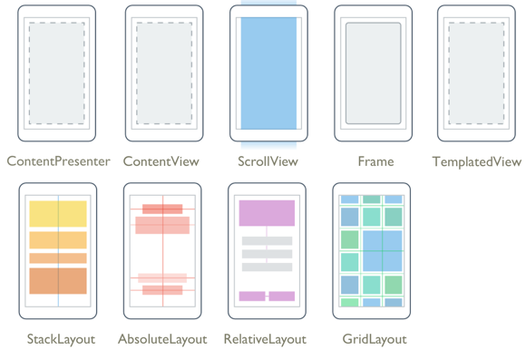
Layouts
Pages
Notes:
Inside of a page are layouts
A lot of options from something simple like a stack panel to complex and powerful grids

Slide 19
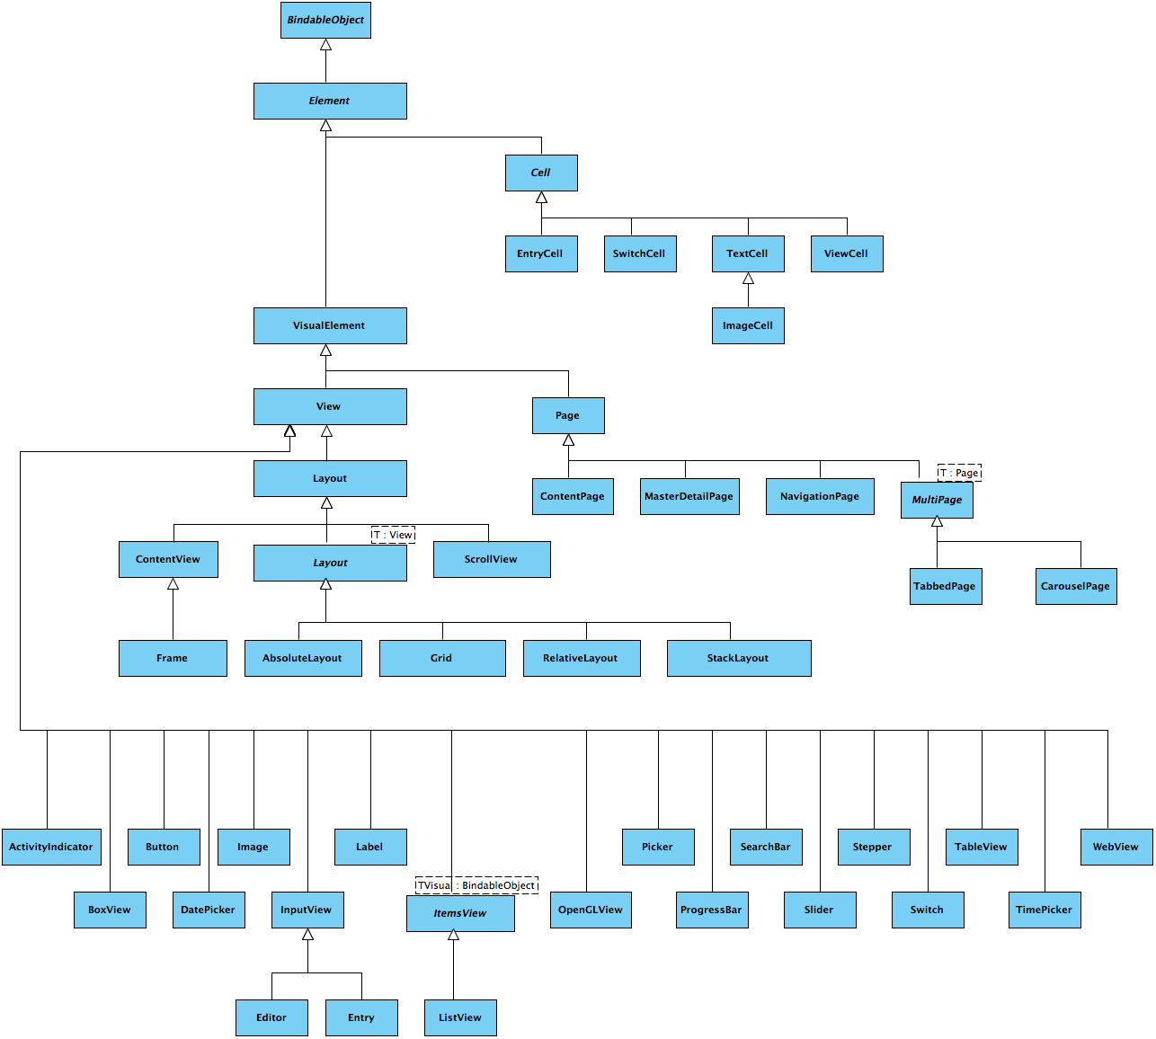
Control Hierarchy
6
9
19
5
Page controls
Layout controls
View controls
Cell controls
Notes:
https://developer.xamarin.com/guides/xamarin-forms/user-interface/controls/
https://developer.xamarin.com/api/type/Xamarin.Forms.Element/
https://developer.xamarin.com/guides/xamarin-forms/user-interface/controls/pages/
https://developer.xamarin.com/guides/xamarin-forms/user-interface/controls/layouts/
https://developer.xamarin.com/guides/xamarin-forms/user-interface/controls/views/
https://developer.xamarin.com/guides/xamarin-forms/user-interface/controls/cells/

Slide 20
How Xamarin.Forms Works

Slide 21
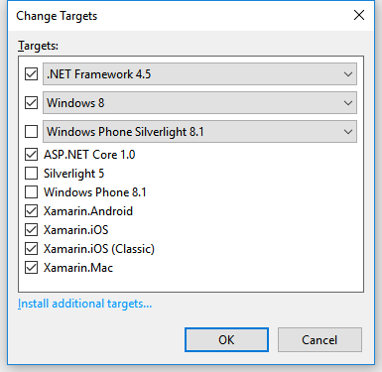
Portable Class Libraries
1 Assembly
Multiple Platforms
Including:
Xamarin.iOS and Xamarin.Android

Slide 22
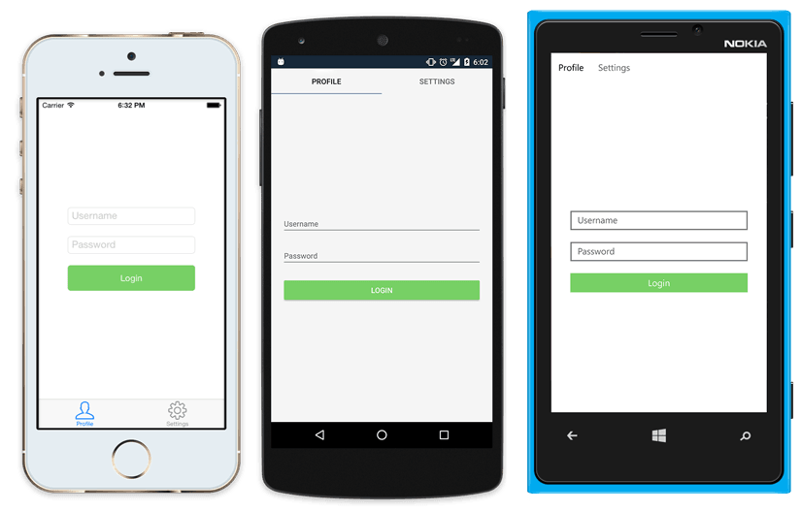
Native UI from shared code
<?xml version="1.0" encoding="UTF-8"?>
<TabbedPage xmlns="http://xamarin.com/schemas/2014/forms"
xmlns:x="http://schemas.microsoft.com/winfx/2009/xaml"
x:Class="MyApp.MainPage">
<TabbedPage.Children>
<ContentPage Title="Profile" Icon="Profile.png">
<StackLayout Spacing="20" Padding="20"
VerticalOptions="Center">
<Entry Placeholder="Username"
Text="{Binding Username}"/>
<Entry Placeholder="Password"
Text="{Binding Password}"
IsPassword="true"/>
<Button Text="Login" TextColor="White"
BackgroundColor="#77D065"
Command="{Binding LoginCommand}"/>
</StackLayout>
</ContentPage>
<ContentPage Title="Settings" Icon="Settings.png">
<!-- Settings -->
</ContentPage>
</TabbedPage.Children>
</TabbedPage>

Slide 23
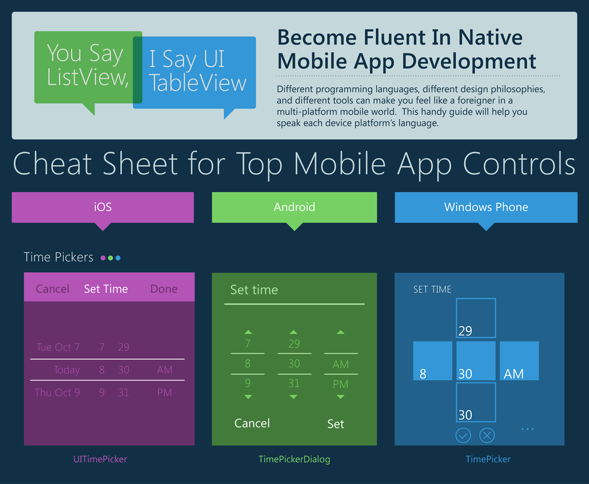
Wrappers around native UI controls
blog.xamarin.com/cheat-sheet-for-top-mobile-app-controls/
Notes:
Xamarin Blog
June 2014
https://blog.xamarin.com/cheat-sheet-for-top-mobile-app-controls/

Slide 24
Control Comparison
Windows | Xamarin.Forms
StackPanel | StackLayout
TextBox | Entry
ListBox | ListView
CheckBox | Switch
ProgressBar | ActivityIndicator
Grid | Grid
Label | Label
Button | Button
Image | Image
Date/TimePicker | Date/TimePicker

Slide 25
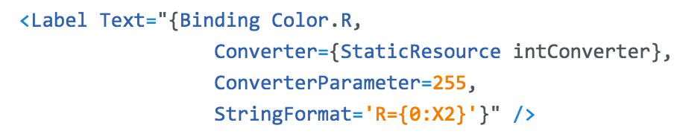
Windows | Xamarin.Forms
DataContext | BindingContext
{Binding Property} | {Binding Property}
ItemsSource | ItemsSource
ItemTemplate | ItemTemplate
DataTemplate | DataTemplate
Binding
Comparison

Slide 26
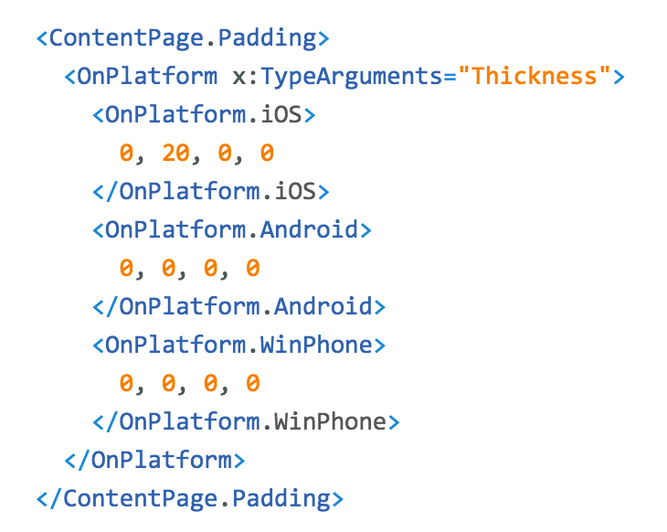
Platform
Customization

Slide 27
Why UWP?

Slide 28
Benefits of using UWP to learn Xamarin.Forms
✓ Faster loading
✓ Launch your app on your PC (Local Machine)
✓ Requires no Android emulators or devices
✓ Requires no Apple machines to build and deploy
✓ Requires no Apple simulators or devices
✓ Works with Visual Studio’s UWP debugging tool
✓ Easy to add UWP to an existing XF solution
developer.xamarin.com/guides/xamarin-forms/platform-features/windows/installation/universal/
Notes:
https://developer.xamarin.com/guides/xamarin-forms/xaml/xamlc/
XAMLC offers a number of a benefits:
It performs compile-time checking of XAML, notifying the user of any errors.
It removes some of the load and instantiation time for XAML elements.
It helps to reduce the file size of the final assembly by no longer including .xaml files.
Turned off by default for backwards compatibility
Only requires adding 1 attribute per assembly or class

Slide 29
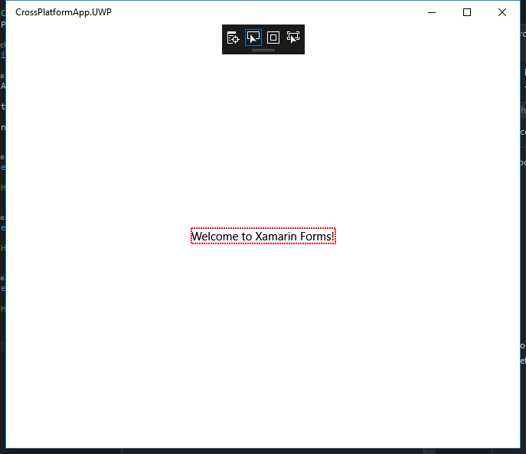
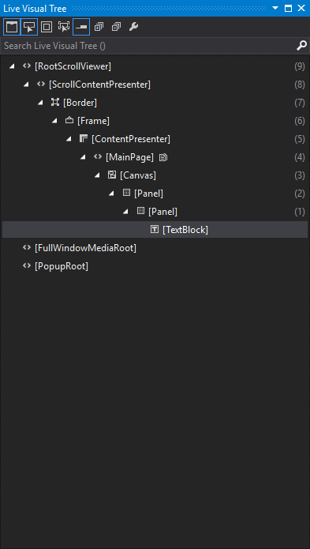
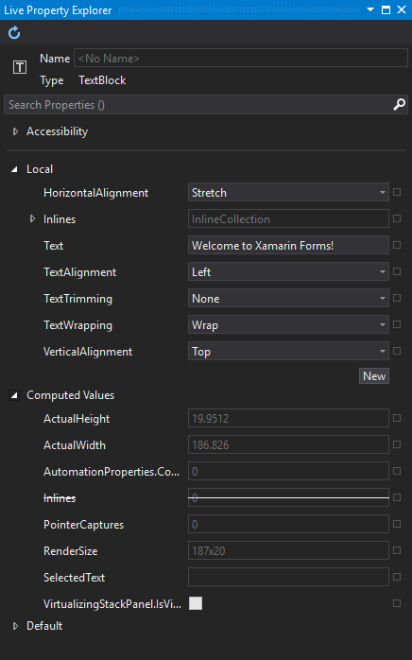
Visual Studio’s UI Debugging Tools for XAML
Shared C# User Interface
blogs.msdn.microsoft.com/visualstudio/2015/02/24/introducing-the-ui-debugging-tools-for-xaml/

Slide 30
What About Data?

Slide 31
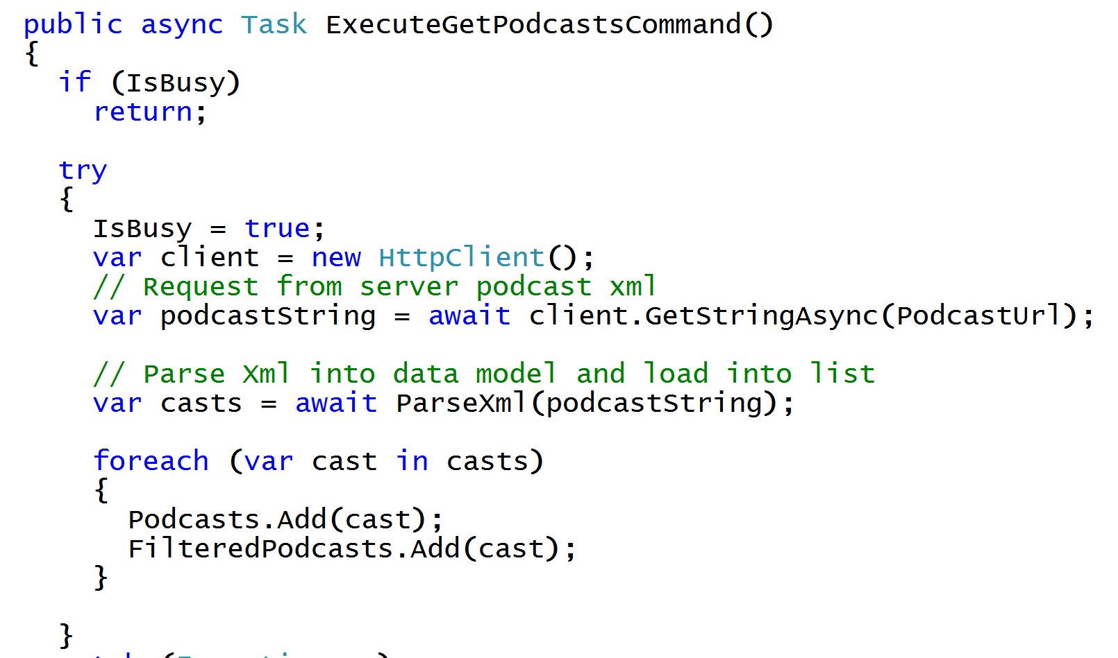
Async/Await
Write Beautiful & Maintainable Code
Notes:
The async and await keywords in C# 5.0 now available to Xamarin developers make asynchronous programming incredibly pleasant.
You end up with code that is much more linear and much easier to understand.
The compiler does a lot of magic for you which simplifies your code and your life.

Slide 32
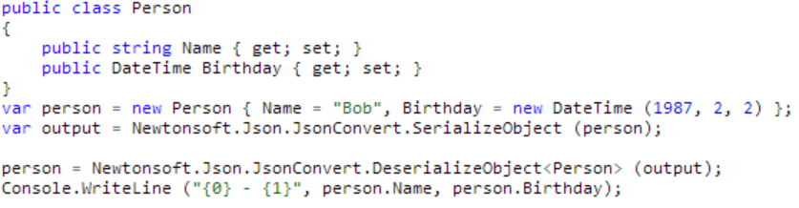
JSON Made Easy
Json.NET offers simple conversations to/from JSON strings and .NET objects:
Notes:
Use your favorite libraries like Json.NET!

Slide 33
Performance Tweaks

Slide 34
XAML Compilation
XAML
XAMLC
Compile-time
Parsed & turned into IL
Runtime
Parsed and inflated
Notes:
https://developer.xamarin.com/guides/xamarin-forms/xaml/xamlc/

Slide 35
Benefits of XAML Compilation
✓ Faster Loading
✓ Smaller App Size
✓ See XAML errors at build time
✓ Easy to implement (add 1 attribute)
developer.xamarin.com/guides/xamarin-forms/xaml/xamlc/
Notes:
https://developer.xamarin.com/guides/xamarin-forms/xaml/xamlc/
XAMLC offers a number of a benefits:
It performs compile-time checking of XAML, notifying the user of any errors.
It removes some of the load and instantiation time for XAML elements.
It helps to reduce the file size of the final assembly by no longer including .xaml files.
Turned off by default for backwards compatibility
Only requires adding 1 attribute per assembly or class

Slide 36
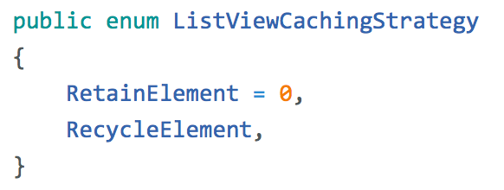
ListView CachingStrategy
✓ Improves scrolling performance
✓ Old behavior is currently the default (but likely to change)

Slide 37
Third-Party Libraries and Controls

Slide 38
Platform Specific Code
UI+APIs
UI + APIs
UI + APIs
Battery
GPS
Lights
Notifications
Settings
Text To Speech
Battery
GPS
Lights
Notifications
Settings
Text To Speech
Battery
GPS
Lights
Notifications
Settings
Text To Speech
What if we didn’t have to write this code?
What if we could access it from shared code?

Slide 39
Plugins for Xamarin
github.com/xamarin/plugins
Common API

Slide 40
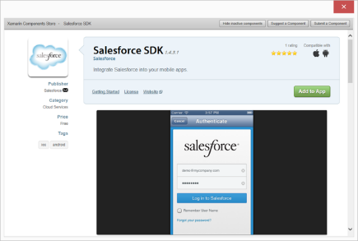
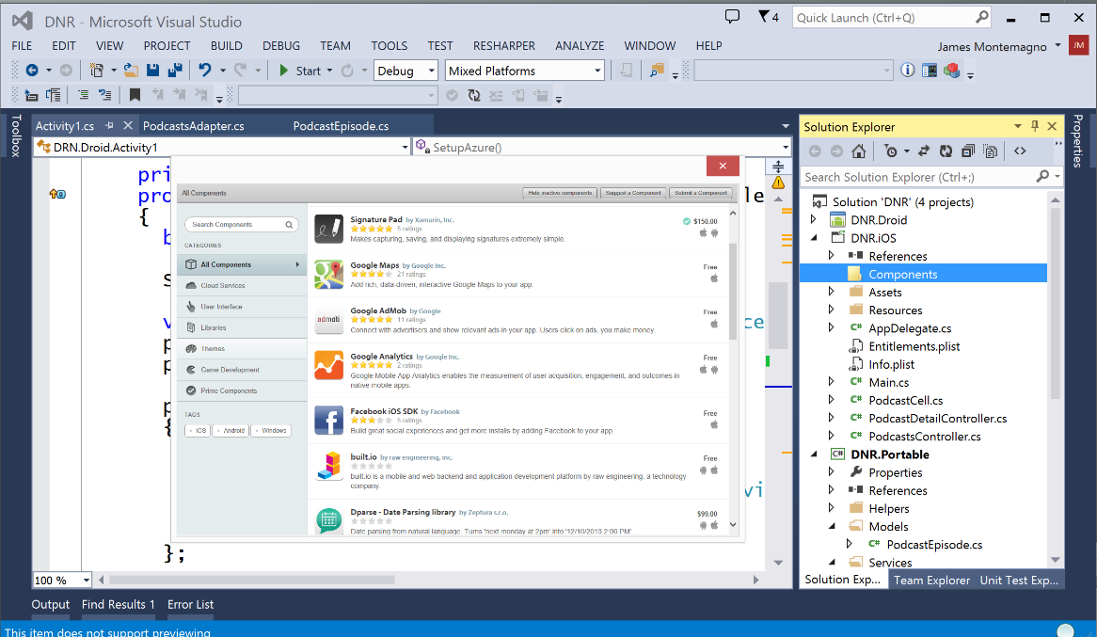
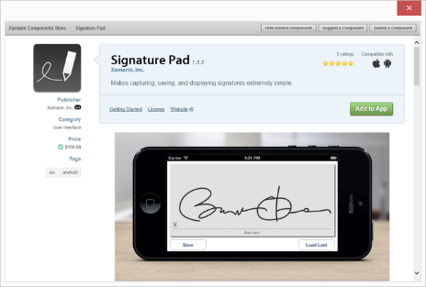
Xamarin Component Store
Build Apps Faster
Add high quality pre-built app components directly from Visual Studio and Xamarin Studio
Beautiful, cross-platform UI controls, cloud services, and enterprise backend integrations are just a few clicks away

Slide 41
Resources

Slide 42
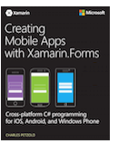
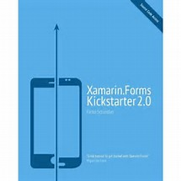

Xamarin.Forms / Mobile Development Books
Charles Petzold
Creating Mobile Apps with Xamarin.Forms
developer.xamarin.com/guides/xamarin-forms/creating-mobile-apps-xamarin-forms/
Falko Schindler
Xamarin.Forms Kickstarter 2.0
www.xforms-kickstarter.com/
Theresa Neil
Mobile Design Pattern Gallery, 2nd Edition
shop.oreilly.com/product/0636920029311.do

Slide 43
Xamarin.Forms Links
Xamarin’s blog
blog.xamarin.com/tag/xamarin-forms/
Xamarin’s developer site for Guides, APIs, Samples
https://developer.xamarin.com/
All About Xamarin (nearly daily) news site
allaboutxamarin.com/
Xamarin.Forms sample code
https://github.com/xamarin/xamarin-forms-samples
Source to Charles Petzold, Creating Mobile Apps with Xamarin.Forms
https://github.com/xamarin/xamarin-forms-book-samples
Xamarin Pre-built App Templates
Xamarin.com/prebuilt

Slide 44
From Microsoft to Mobile Learning Xamarin.Forms through UWP
Andy Lech
XamarinFiles.com
github.com/xamarinfiles
@XamarinFiles

